Slide 1
Algorithms
Dr. Ahmad Hassanat
Introduction
Proof By Induction
Asymptotic notation

Slide 2
What is course about?
The theoretical study of design and analysis of computer algorithms
Basic goals for an algorithm:
always correct
always terminates
This class: performance
  Performance often draws the line between
what is possible and what is impossible.

Slide 3
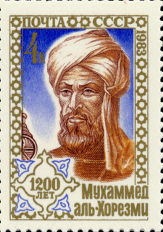
What is a Computer Algorithm?
An algorithm is a sequence of unambiguous instructions for solving a problem, for obtaining a required output for any legitimate input in a finite amount of time.
Abu Abdallah Muhammad ibn Musa al-Khwarizmi

Slide 4
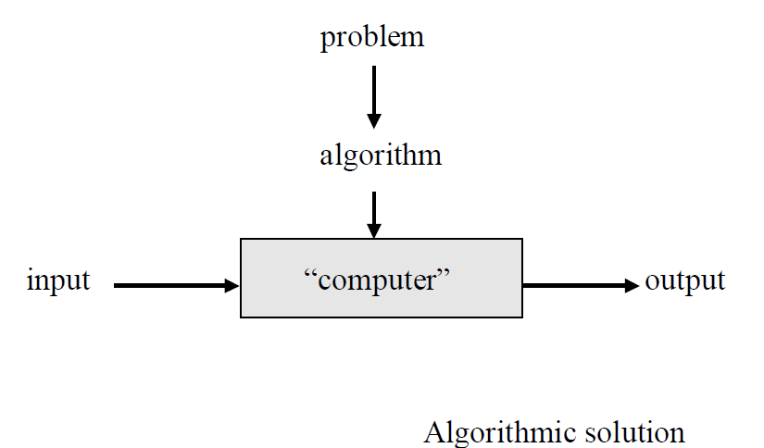
Notion of algorithm

Slide 5
Features of Algorithm
– finiteness (otherwise: computational method)
  terminates after a finite number of steps
– definiteness
  precise definition of each step
– input (zero or more)
  valid inputs are clearly specified
– output (one or more)
  can be proved to produce the correct output given a valid input
– effectiveness
  steps are sufficiently simple and basic

Slide 6
Classification of Algorithms
– By implementation
  Recursion or iteration
  Serial or parallel or distributed
  Deterministic or non-deterministic
  Exact or approximate
– By design paradigm
  Brute-force (exhaustive search)
  Divide and conquer
  Dynamic programming
  The greedy method …
– By field of study
  search algorithms, sorting algorithms, merge algorithms, etc
– By complexity
  Space complexity and Time complexity

Slide 7
Review: Induction
Suppose
  S(k) is true for fixed constant k
    Often k = 0
  S(n) → S(n+1) for all n >= k
Then S(n) is true for all n >= k

Slide 8
Proof By Induction
Claim:S(n) is true for all n >= k
Basis:
  Show formula is true when n = k
Inductive hypothesis:
  Assume formula is true for an arbitrary n
Step:
  Show that formula is then true for n+1

Slide 9
Induction Example:
Gaussian Closed Form
Prove 1 + 2 + 3 + … + n = n(n+1) / 2
  Basis:
    If n = 0, then 0 = 0(0+1) / 2
  Inductive hypothesis:
    Assume 1 + 2 + 3 + … + n = n(n+1) / 2
  Step (show true for n+1):
    1 + 2 + … + n + n+1 = (1 + 2 + …+ n) + (n+1)
    = n(n+1)/2 + n+1 = [n(n+1) + 2(n+1)]/2
    = (n+1)(n+2)/2 = (n+1)(n+1 + 1) / 2

Slide 10
Induction Example:
Geometric Closed Form
Prove a⁰ + a¹ + … + a^{n} = (a^{n+1} - 1)/(a - 1) for all a ≠ 1
  Basis: show that a⁰ = (a⁰⁺¹ - 1)/(a - 1)
    a⁰ = 1 = (a¹ - 1)/(a - 1)
  Inductive hypothesis:
    Assume a⁰ + a¹ + … + a^{n} = (a^{n+1} - 1)/(a - 1)
  Step (show true for n+1):
    a⁰ + a¹ + … + a^{n+1} = a⁰ + a¹ + … + a^{n} + a^{n+1}
    = (a^{n+1} - 1)/(a - 1) + a^{n+1} = (a^{n+1+1} - 1)/(a - 1)

Slide 11
Induction
We’ve been using weak induction
Strong induction also holds
  Basis: show S(0)
  Hypothesis: assume S(k) holds for arbitrary k <= n
  Step: Show S(k+1) follows
Another variation:
  Basis: show S(0), S(1)
  Hypothesis: assume S(n) and S(n+1) are true
  Step: show S(n+2) follows

Slide 12
Asymptotic Performance
In this course, we care most about asymptotic performance
  How does the algorithm behave as the problem size gets very large?
    Running time
    Memory/storage requirements
    Bandwidth/power requirements/logic gates/etc.

Slide 13
Asymptotic Notation
By now you should have an intuitive feel for asymptotic (big-O) notation:
  What does O(n) running time mean? O(n²)?
  O(n lg n)?
  How does asymptotic running time relate to asymptotic memory usage?
Our first task is to define this notation more formally and completely

Slide 14
Analysis of Algorithms
How good is the algorithm?
  Correctness
  Time efficiency
  Space efficiency
Does there exist a better algorithm?
  Lower bounds
  Optimality

Slide 15
Analysis of Algorithms
Analysis is performed with respect to a computational model
We will usually use a generic uniprocessor random-access machine (RAM)
  All memory equally expensive to access
  No concurrent operations
  All reasonable instructions take unit time
    Except, of course, function calls
  Constant word size
    Unless we are explicitly manipulating bits

Slide 16
Input Size
Time and space complexity
  This is generally a function of the input size
    E.g., sorting, multiplication
  How we characterize input size depends:
    Sorting: number of input items
    Multiplication: total number of bits
    Graph algorithms: number of nodes & edges
    Etc

Slide 17
Running Time
Number of primitive steps that are executed
  Except for time of executing a function call most statements roughly require the same amount of time
    y = m * x + b
    c = 5 / 9 * (t - 32 )
    z = f(x) + g(y)
We can be more exact if need be

Slide 18
Analysis
Best-case: (NEVER)
  Cheat with a slow algorithm that works fast on some input
Worst case (usually)
  Provides an upper bound on running time
  An absolute guarantee
Average case (sometimes)
  Provides the expected running time
  Very useful, but treat with care: what is “average”?
    Random (equally likely) inputs
    Real-life inputs

Slide 19
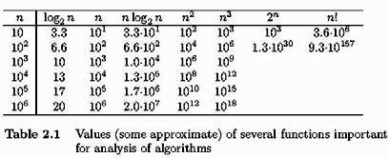
Complexity of Algorithms

Slide 20

Complexity of Algorithms

Slide 21
Complexity of Algorithms
Name | Running time (T(n)) | Examples of running times | Examples of algorithms
constant time | O(1) | 10 | Determining if a number is even or odd
log-logarithmic | O(log log n) |  | Amortized time per operation using a bounded priority queue
logarithmic time | O(log n) | log n, log(n²) | Binary search
linear time | O(n) | n | Finding the smallest item in an unsorted array
linearithmic time | O(n log n) | n log n, log n! | Fastest possible comparison sort
quadratic time | O(n²) | n² | Bubble sort; Insertion sort
cubic time | O(n³) | n³ | Naive multiplication of two n×n matrices. Calculating partial correlation.
polynomial time | 2^{O(log n)} = poly(n) | n, n log n, n¹⁰ | Karmarkar's algorithm for linear programming; AKS primality test
exponential time | 2^{O(n)} | 1.1^{n}, 10^{n} | Solving the traveling salesman problem using dynamic programming
factorial time | O(n!) | n! | Solving the traveling salesman problem via brute-force search

Slide 22
The End

